Slide 1
Presentation brief for MCT’s
Title of presentation | Transform data with Azure Data Factory or Azure Synapse Pipelines
Presentation\Lab length | Presentation: 50 - 60 minutes Lab: 80 – 90 minutes
Audience | Data Engineers, Data Scientists, Data Professionals, Data Architects, BI Professionals, Developers
Purpose | Introduce Azure Data Factory (ADF)/Synapse Pipelines and how it can help in the batch processing of data Understand how Azure Data Factory/Synapse Pipelines can be used to integrate many other technologies together
(think) Student key takeaways | The student should be able to explain the components of Azure Data Factory/Azure Synapse Pipelines The student should be able to use the mapping data flow The student should be able to monitor executing pipelines
(feel) Student desired mindset | The student may feel that this is complex, and it is your teaching that will bring confidence to them The student may like they are not sure what transformation is and the options available to do it in ADF
(do) Student outcomes | The student should be able each component of Azure Data Factory/Azure Synapse Pipelines The student should be able to us the mapping data flow in Azure Data Factory/Azure Synapse Pipelines
More information | For MCT course feedback, visit the Microsoft Official Courseware forum
Notes:
Instructor notes and guidance.
This slide is for MCT use only, outlining the aims and objectives of this module.

Slide 2
DP-203T00: Transform data with Azure Data Factory or Azure Synapse Pipelines
Notes:
Instructor notes and guidance.
If you have taught DP-200, Implementing an Azure Data Solution, this module will be familiar as it uses content from module 7 of that course to teach Azure Data Factory/Azure Synapse Analytics Pipelines. There are new labs for the students to explore, and we have provided examples of how to deal with “dirty data sources” to provide a contrived example of dealing with data sources. The first part of this modules should be focused on the components of Azure Data factory. In fact, you could run this two minute animation on this page as an introduction to the components before you go deeper with the learning
Understand Azure Data Factory components - Learn | Microsoft Docs
The second part of the module explores Mapping Data Flow. Our recommendation is that you show a small example that incorporates the following
How to start the mapping data flow
How to add a source
How to add 1 transformation
How to add a sink
Beyond that, explain to the students that they will learn more by using it in the lab. As a result, we have provided two mapping data flow examples in the lab for them to explore.

Slide 3

Agenda
Lesson 01 – Data integration with Azure Data Factory or Azure Synapse Pipelines
Lesson 02 – Code-free transformation at scale with Azure Data Factory or Azure Synapse Pipelines
Notes:
Instructor notes and guidance.
This space has been left deliberately blank.

Slide 4
Lesson 01: Data integration with Azure Data Factory or Azure Synapse Pipelines
Notes:
Instructor notes
This space has been left deliberately blank

Slide 5








Data integration with Azure Data Factory or Azure Synapse Pipelines
@
Triggers
Parameters
Linked Service
IR
Integration
Runtime
CF
Control
Flow
Pipeline
Data Lake Store
1
Activities
Azure Databricks
Dataset
Notes:
<< NOTE. This slide also appears in module 5, and is included if you need to use it in this module>>
Talking points
Let’s have a closer look at the components of Azure Data Factory
Linked services
Linked services are much like connection strings, which define the connection information that's needed for Data Factory to connect to external resources. Think of it this way: a linked service defines the connection to the data source, and a dataset represents the structure of the data. For example, an Azure Storage-linked service specifies a connection string to connect to the Azure Storage account. Additionally, an Azure blob dataset specifies the blob container and the folder that contains the data.
Linked services are used for two purposes in Data Factory:
To represent a data store that includes, but isn't limited to, an on-premises SQL Server database, Oracle database, file share, or Azure blob storage account. For a list of supported data stores, see the copy activity article.
To represent a compute resource that can host the execution of an activity. For example, the HDInsight Hive activity runs on an HDInsight Hadoop cluster. For a list of transformation activities and supported compute environments, see the transform data article.
Datasets
Datasets represent data structures within the data stores, which simply point to or reference the data you want to use in your activities as inputs or outputs.
Activity
Activities represent a processing step in a pipeline. For example, you might use a copy activity to copy data from one data store to another data store. Similarly, you might use a Hive activity, which runs a Hive query on an Azure HDInsight cluster, to transform or analyze your data. Data Factory supports three types of activities: data movement activities, data transformation activities, and control activities.
Pipeline
A data factory might have one or more pipelines. A pipeline is a logical grouping of activities that performs a unit of work. Together, the activities in a pipeline perform a task. For example, a pipeline can contain a group of activities that ingests data from an Azure blob, and then runs a Hive query on an HDInsight cluster to partition the data.
The benefit of this is that the pipeline allows you to manage the activities as a set instead of managing each one individually. The activities in a pipeline can be chained together to operate sequentially, or they can operate independently in parallel.
Triggers
Triggers represent the unit of processing that determines when a pipeline execution needs to be kicked off. There are different types of triggers for different types of events.
Pipeline runs
A pipeline run is an instance of the pipeline execution. Pipeline runs are typically instantiated by passing the arguments to the parameters that are defined in pipelines. The arguments can be passed manually or within the trigger definition.
Parameters
Parameters are key-value pairs of read-only configuration. Parameters are defined in the pipeline. The arguments for the defined parameters are passed during execution from the run context that was created by a trigger or a pipeline that was executed manually. Activities within the pipeline consume the parameter values.
A dataset is a strongly typed parameter and a reusable/referenceable entity. An activity can reference datasets and can consume the properties that are defined in the dataset definition.
A linked service is also a strongly typed parameter that contains the connection information to either a data store or a compute environment. It is also a reusable/referenceable entity.
Control flow
Control flow is an orchestration of pipeline activities that includes chaining activities in a sequence, branching, defining parameters at the pipeline level, and passing arguments while invoking the pipeline on-demand or from a trigger. It also includes custom-state passing and looping containers, that is, For-each iterators.
Integration Runtime
Integration Runtime is referenced by the linked service or activity, and provides the compute environment where the activity either runs on or gets dispatched from. Data Factory offers three types of Integration Runtime, and you should choose the type that best serve the data integration capabilities and network environment needs you are looking for. These three types are:
Azure - Copying between two cloud data sources:
Self-hosted - Copying between a cloud data source and a data source in private network
Azure-SSIS - Copying between two data sources in private network (only supported in Azure Data Factory, not Azure Synapse Pipelines)
Instructor notes and guidance.
This slide is a build slide, please make sure that you are familiar with the order that the items appear.
Click 1 – Enable you to speak about Linked Services:
Click 2 – Use Data Lake Store as a storage resource example
Click 3 – Use Databricks as a compute resource example
Click 4 – Enables you to talk about the Dataset object
Click 5 – this is a graphic to show a flow of data
Click 6 – Bring up the word activity
Click 7 – shows a rotating cog to reflect a single activity
Click 8 – removes the word activity
Click 9 - shows multiple rotating cogs to reflect multiple activities
Click 10 – Shows a funnel with the word pipeline to show that activities are grouped into a pipeline.
Click 11 – The word trigger appears with a circular arrow
Click 12 – The circular arrow rotates to indicate that a pipeline is triggered to execute
Click 13 - nothing happens
Click 14 – a number 1 appears out of the data and flows through the pipeline into the data set to reflect data being transformed by the activities in a pipeline
Click 15 - The word Parameters with an @ symbol appears
Click 16 – The word Integration runtime appears with an IR icon
Click 17 - The word Control Flow appears with the CF icon
Recommended reading for this slide
https://docs.microsoft.com/en-us/learn/modules/data-integration-azure-data-factory/

Slide 6
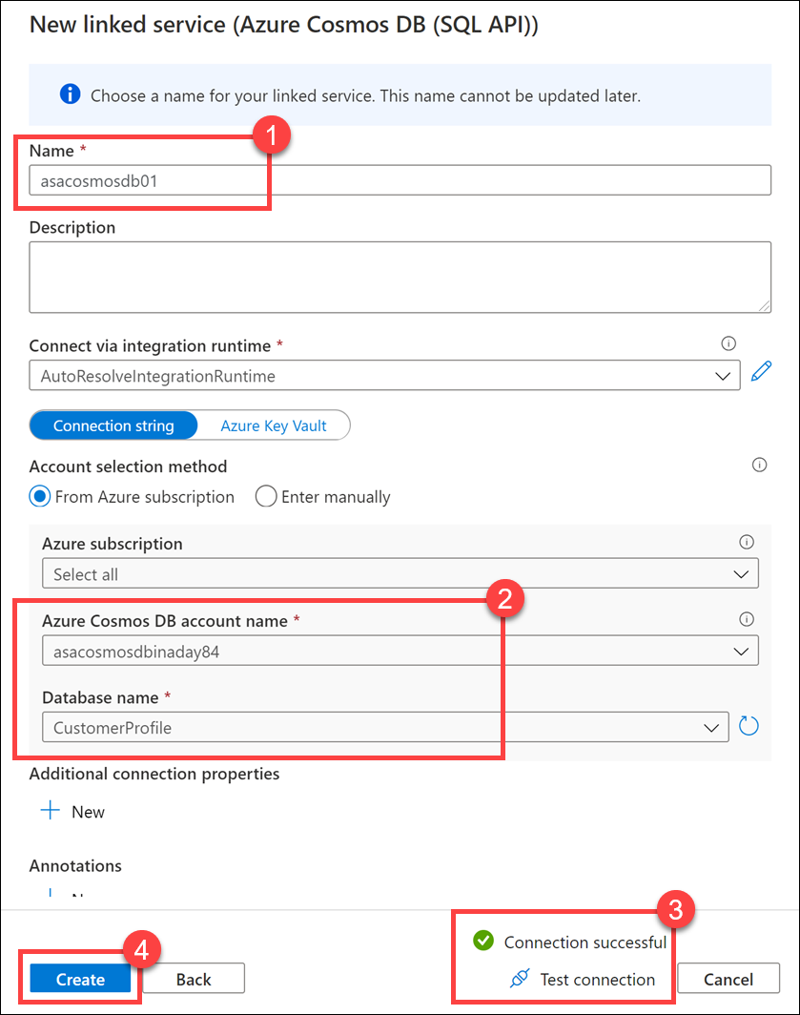
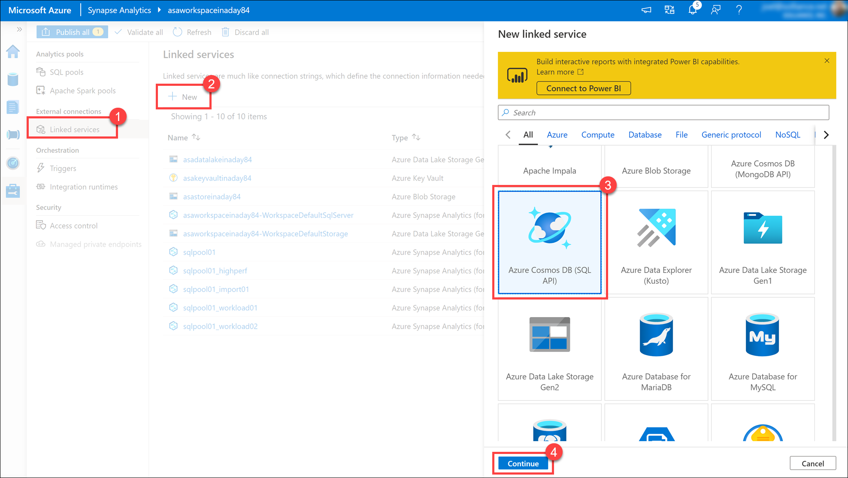
Linked Services
Notes:
Talking points
Before you create a dataset, you must create a linked service to link your data store to the data factory/Synapse pipeline. Linked services are much like connection strings, which define the connection information needed for Data Factory to connect to external resources. There are over 100 connectors that can be used to define a linked service.
A linked service in Data Factory can be defined using the Copy Data Activity in the ADF designer, or you can create them independently to point to a data store or a compute resources.
Instructor notes and guidance.
Use the example on the slide to highlight to students that you can create linked services through a UI, but you can also create then programmatically using JSON. You could use the following example if anyone asks for an example of the syntax
{
"name": "<Name of the linked service>",
"properties": {
"type": "<Type of the linked service>",
"typeProperties": {
"<data store or compute-specific type properties>"
},
"connectVia": {
"referenceName": "<name of Integration Runtime>",
"type": "IntegrationRuntimeReference"
}
}
}
Recommended reading for this slide
https://docs.microsoft.com/en-us/learn/modules/data-integration-azure-data-factory/8-create-linked-services?ns-enrollment-type=LearningPath&ns-enrollment-id=learn.wwl.data-integration-scale-azure-data-factory

Slide 7
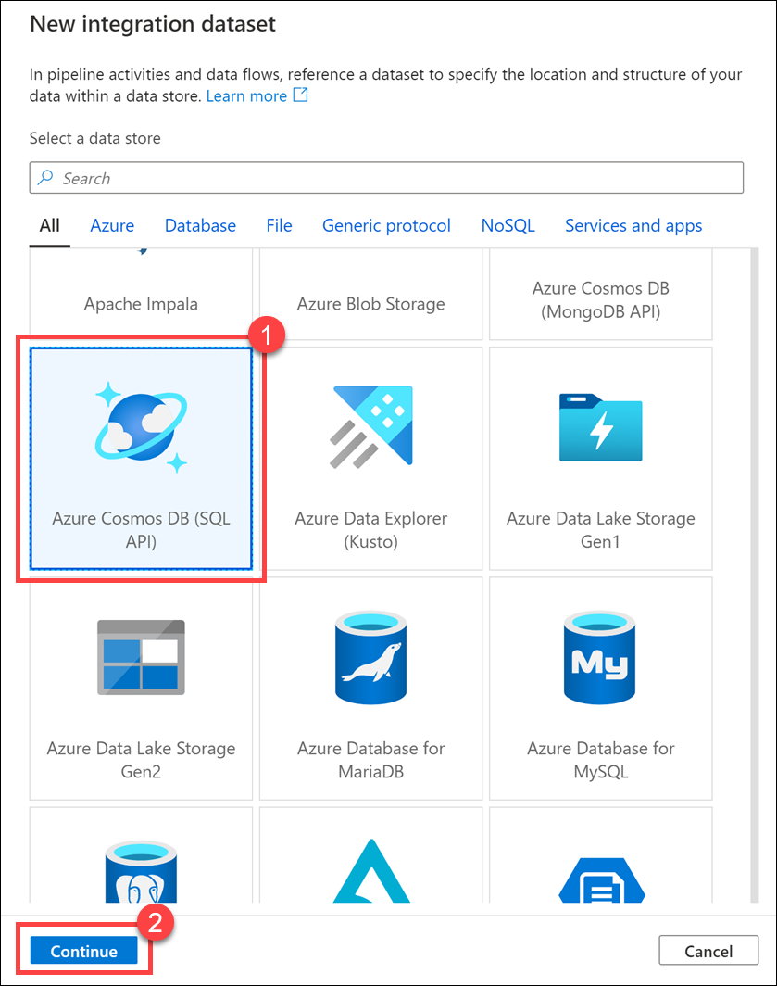
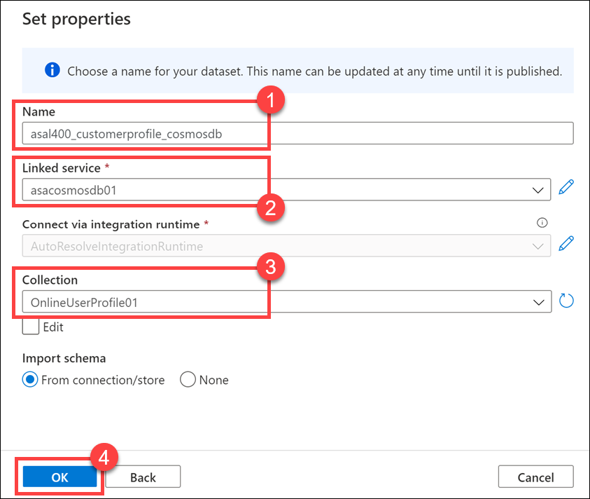
Datasets
Notes:
Talking points
A dataset is a named view of data that simply points or references the data you want to use in your activities as inputs and outputs. Datasets identify data within different data stores, such as tables, files, folders, and documents. For example, an Azure Blob dataset specifies the blob container and folder in Blob storage from which the activity should read the data.
Before you create a dataset, you must create a linked service to link your data store to the data factory.
Instructor notes and guidance.
Share with the students that during the lab, they will be creatin more than three integration datasets against different types of data stores ranging from Azure Data Lake, Synapse Analytics and Cosmos DB. Ask the students to think about the datasets and linked services they would need to create to build solutions within their own organization
Recommended reading for this slide
https://docs.microsoft.com/en-us/learn/modules/data-integration-azure-data-factory/9-create-datasets

Slide 8
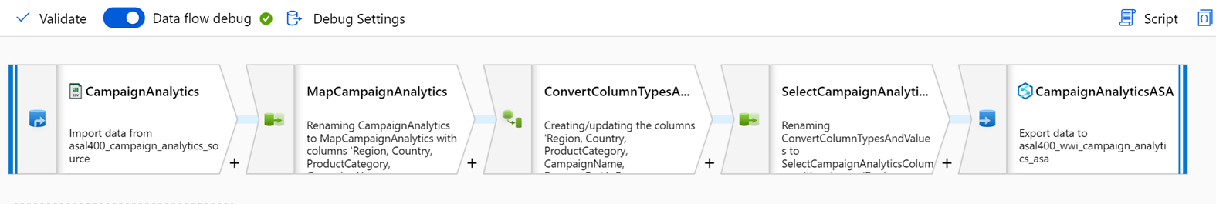
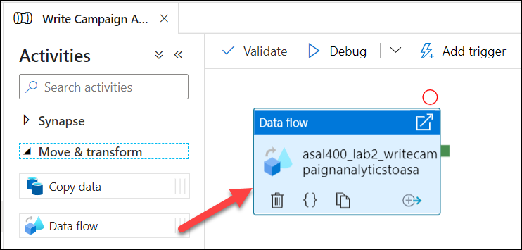
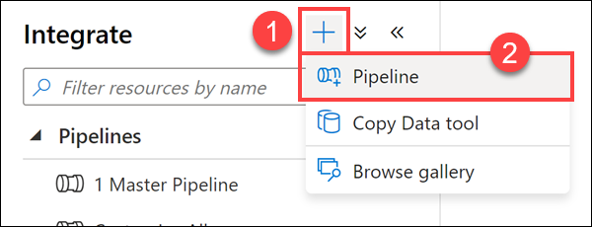
Activities and pipelines
Notes:
Talking points
A data factory can have one or more pipelines. A pipeline is a logical grouping of activities that together perform a task. For example, a pipeline could contain a set of activities that ingest and clean log data, and then kick off a mapping data flow to analyze the log data. The pipeline allows you to manage the activities as a set instead of each one individually. You deploy and schedule the pipeline instead of the activities independently.
The activities in a pipeline define actions to perform on your data. For example, you may use a copy activity to copy data from SQL Server to an Azure Blob Storage. Then, use a data flow activity or a Databricks Notebook activity to process and transform data from the blob storage to an Azure Synapse Analytics pool on top of which business intelligence reporting solutions are built.
Data Factory has three groupings of activities: data movement activities, data transformation activities, and control activities. An activity can take zero or more input datasets and produce one or more output datasets.
Instructor notes and guidance.
Thinking about the organization of the activities that take place within a pipeline is an important part of creating pipelines. You don’t want to create one monolithic pipeline that manages all of your data integration pipelines as it will become too cumbersome to manage and develop. Typically, you will break pipelines down into discrete units of manageable data integration pipelines. Azure Data Factory/Synapse pipeline has an execute pipeline activity that enables you to control the execution of the pipelines to manage this.
Recommended reading for this slide
https://docs.microsoft.com/en-us/learn/modules/data-integration-azure-data-factory/10-create-activities-pipelines

Slide 9
Lesson 01: Code-free transformation at scale with Azure Data Factory or Azure Synapse Pipelines
Notes:
Instructor notes
This space has been left deliberately blank

Slide 10
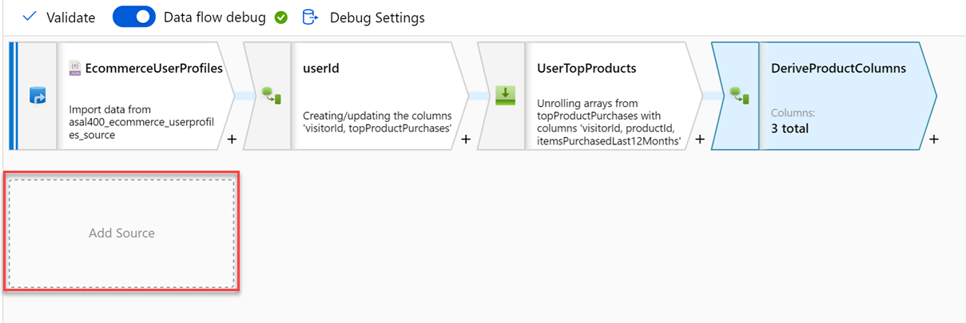
Code-free transformation at scale with Azure Data Factory or Azure Synapse Pipelines
Notes:
Talking points
Let’s dive into the data flow mapping
Mapping data flows are visually designed data transformations in Azure Data Factory or Azure Synapse Pipelines.
Data flows allow data engineers to develop graphical data transformation logic without writing code.
The resulting data flows are executed as activities within Azure Data Factory pipelines that use scaled-out Spark clusters.
Data flow activities can be operationalized via existing Data Factory scheduling, control, flow, and monitoring capabilities. Mapping data flows provide a fully visual experience with no coding required.
Your data flows will run on your own execution cluster for scaled-out data processing. Azure Data Factory handles all the code translation, path optimization, and execution of your data flow jobs.
Data Flow mapping brings the following benefits and capabilities:
- Perform data cleansing, transformation, aggregations, etc.
- Enables you to build resilient data flows in a code free environment
- Enable you to focus on building business logic and data transformation
- Underlying infrastructure is provisioned automatically with cloud scale via Spark execution
Like many data transformation tools, Mapping Data Flow in Azure Data factory supports a great variety of data transformations.
Instructor notes and guidance.
Note that this content is valid for both Azure Data Factory and Azure Synapse Pipelines. Consider showing an example through a demo, you should consider replaying some of the activities done in the lab. The feedback from MCTs about DP200 is that many students needed help the ADF lab, so replaying the mapping data flow should be considered
Recommended reading for this slide
https://docs.microsoft.com/en-us/learn/modules/code-free-transformation-scale/

Slide 11
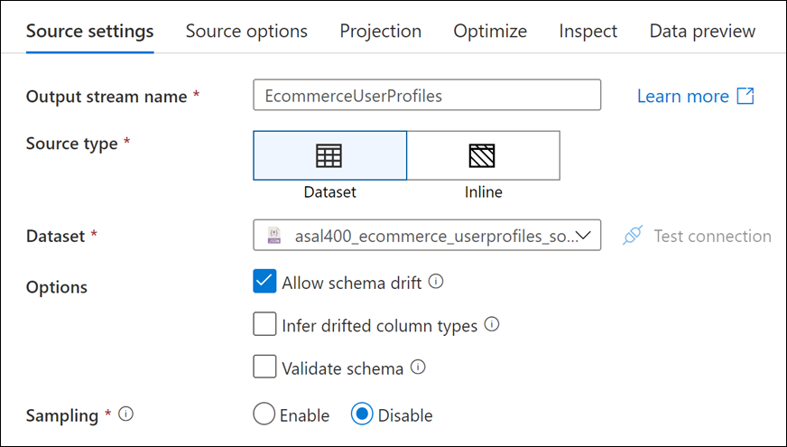
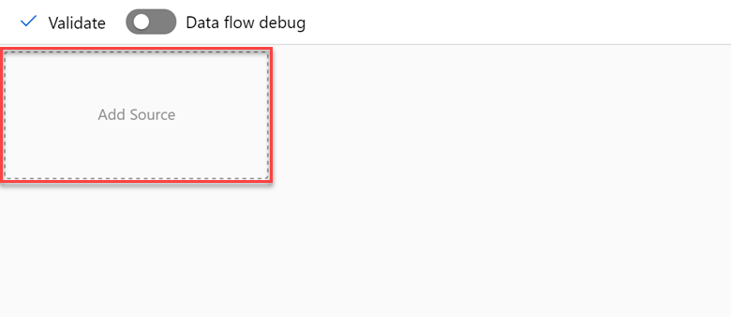
Adding a source
Notes:
Talking points
Azure Data Factory/Synapse pipeline has support for over 100 connectors, and these are typically seen when you add a source to the pipeline. The list of connectors is constantly changing and for the latest list of supports connectors go to the following url https://docs.microsoft.com/en-us/azure/data-factory/connector-overview. Every data flow requires at least one source transformation, but you can add as many sources as necessary to complete your data transformations. You can join those sources together with a join, lookup, or a union transformation.
Each source transformation is associated with exactly one dataset or linked service, and you then define whether the source type is either a dataset or an inline dataset, there are benefits to both. Dataset objects are reusable entities that can be used in other data flows and activities such as Copy. These reusable entities are especially useful when you use a hardened schema. Datasets aren't based in Spark. Occasionally, you might need to override certain settings or schema projection in the source transformation.
Inline datasets are recommended when you use flexible schemas, one-off source instances, or parameterized sources. If your source is heavily parameterized, inline datasets allow you to not create a "dummy" object. Inline datasets are based in Spark, and their properties are native to data flow.
Instructor notes and guidance.
Share with the students that in the lab they will be exposed to creating both integration dataset and inline datasets.
Recommended reading for this slide
https://docs.microsoft.com/en-us/azure/data-factory/data-flow-source

Slide 12
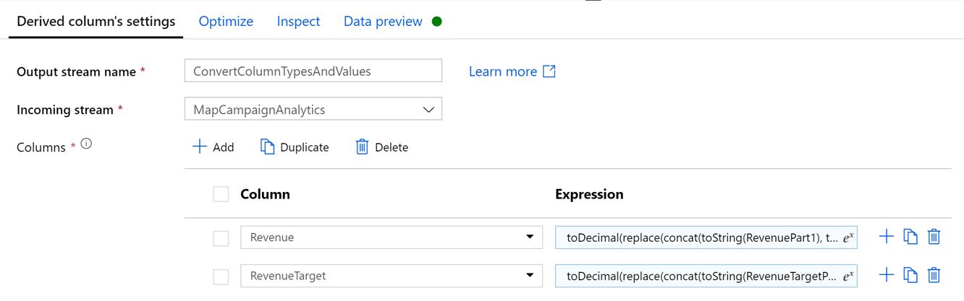
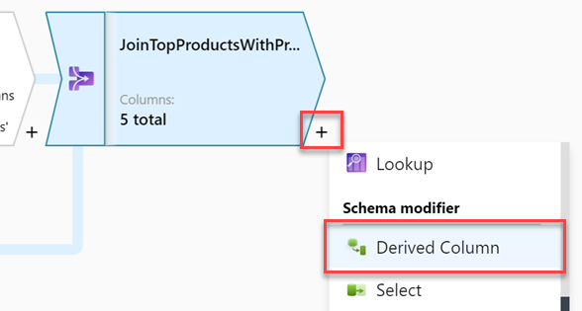
Schema modifier transformations
Notes:
Talking points
Schema modifier transformations will make changes to the structure of the data. This could include renaming, dropping, or reordering columns. Create new columns based on expressions, or aggregate data. The example on the screen is one of a derived column. When creating a derived column, you can either generate a new column or update an existing one. In the Column textbox, enter in the column you are creating. To override an existing column in your schema, you can use the column dropdown. To build the derived column's expression, click on the Enter expression textbox. You can either start typing your expression or open up the expression builder to construct your logic.
Instructor notes and guidance.
In mapping data flow, many transformation properties are entered as expressions. These expressions are composed of column values, parameters, functions, operators, and literals that evaluate to a Spark data type at run time. Mapping data flows has a dedicated experience aimed to aid you in building these expressions called the Expression Builder. Utilizing IntelliSense code completion for highlighting, syntax checking, and autocompleting, the expression builder is designed to make building data flows easy. This article explains how to use the expression builder to effectively build your business logic.
Recommended reading for this slide
https://docs.microsoft.com/en-us/azure/data-factory/data-flow-derived-column#building-schemas-using-the-expression-builder
https://docs.microsoft.com/en-us/azure/data-factory/data-flow-select
https://docs.microsoft.com/en-us/azure/data-factory/data-flow-aggregate

Slide 13
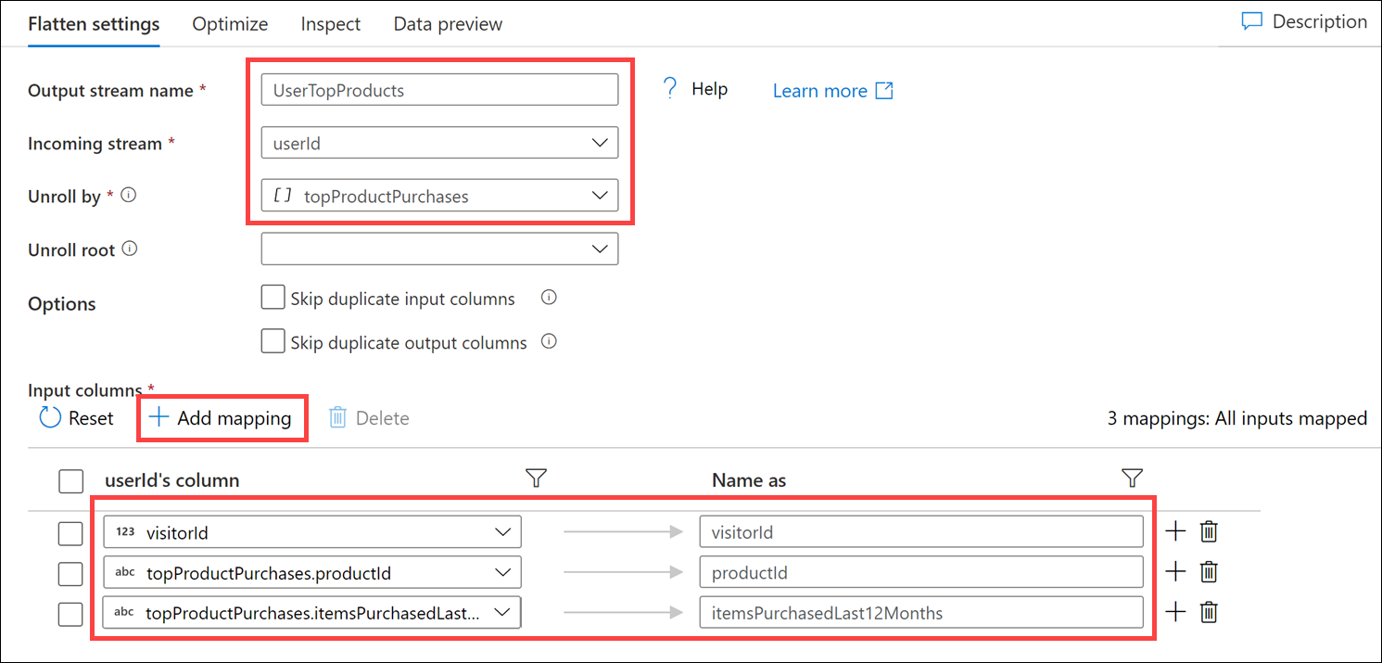
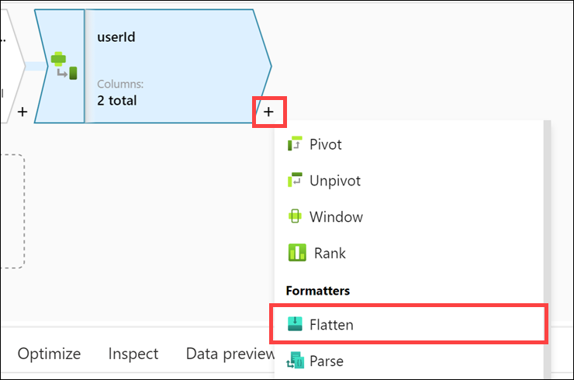
Formatter transformations
Notes:
Talking points
Within the formatters category of transformations there are two transformations; flatten and parse. Use the flatten transformation to take array values inside hierarchical structures such as JSON and unroll them into individual rows. This process is known as denormalization. Use the Parse transformation to parse columns in your data that are in document form. The current supported types of embedded documents that can be parsed are JSON, XML, and delimited text.
The flatten transformation contains the following configuration settings.
Unroll by
Select an array to unroll. The output data will have one row per item in each array
Unroll root
By default, the flatten transformation unrolls an array to the top of the hierarchy it exists in. You can optionally select an array as your unroll root.
Flatten mapping
Similar to the select transformation, choose the projection of the new structure from incoming fields and the denormalized array. If a denormalized array is mapped, the output column will be the same data type as the array. If the unroll by array is an array of complex objects that contains subarrays, mapping an item of that subarray will output an array.
Refer to the inspect tab and data preview to verify your mapping output.
Instructor notes and guidance.
Explain to the students that they will use the flatten transformation in the lab
Recommended reading for this slide
https://docs.microsoft.com/en-us/azure/data-factory/data-flow-flatten
https://docs.microsoft.com/en-us/azure/data-factory/data-flow-parse

Slide 14
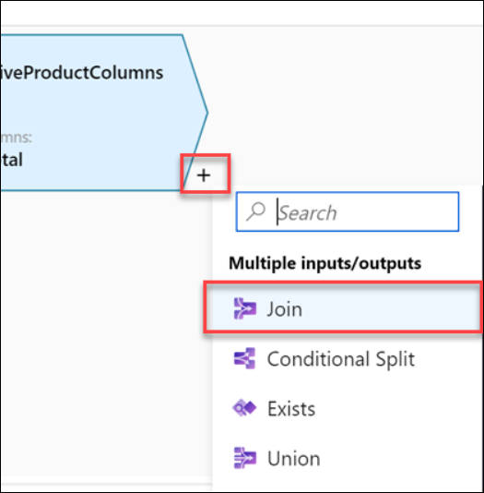
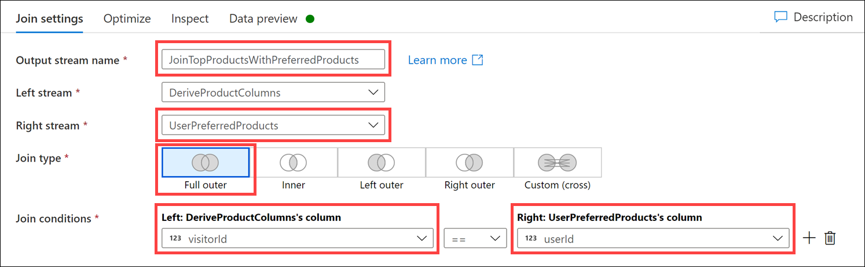
Multiple inputs/outputs transformations
Notes:
Talking points
In the category of multiple inputs/outputs transformations there a variety of transformations that can be used to bring data together, or to output data to new data paths. These transformations include:
Join
Use the join transformation to combine data from two sources or streams in a mapping data flow. The output stream will include all columns from both sources matched based on a join condition.
Conditional Split
The conditional split transformation routes data rows to different streams based on matching conditions. The conditional split transformation is similar to a CASE decision structure in a programming language. The transformation evaluates expressions, and based on the results, directs the data row to the specified stream.
Exists
The exists transformation is a row filtering transformation that checks whether your data exists in another source or stream. The output stream includes all rows in the left stream that either exist or don't exist in the right stream. The exists transformation is similar to SQL WHERE EXISTS and SQL WHERE NOT EXISTS.
Union
Union will combine multiple data streams into one, with the SQL Union of those streams as the new output from the Union transformation. All of the schema from each input stream will be combined inside of your data flow, without needing to have a join key.
Lookup
Use the lookup transformation to reference data from another source in a data flow stream. The lookup transformation appends columns from matched data to your source data.
A lookup transformation is similar to a left outer join. All rows from the primary stream will exist in the output stream with additional columns from the lookup stream.
Instructor notes and guidance.
Go through the join types that are support in the join transformation, as this is a common transformation that are used in ELT/ETL pipelines
Inner Join
Inner join only outputs rows that have matching values in both tables.
Left Outer
Left outer join returns all rows from the left stream and matched records from the right stream. If a row from the left stream has no match, the output columns from the right stream are set to NULL. The output will be the rows returned by an inner join plus the unmatched rows from the left stream.
Right Outer
Right outer join returns all rows from the right stream and matched records from the left stream. If a row from the right stream has no match, the output columns from the left stream are set to NULL. The output will be the rows returned by an inner join plus the unmatched rows from the right stream.
Full Outer
Full outer join outputs all columns and rows from both sides with NULL values for columns that aren't matched.
Custom cross join
Cross join outputs the cross product of the two streams based upon a condition. If you're using a condition that isn't equality, specify a custom expression as your cross join condition. The output stream will be all rows that meet the join condition.
Recommended reading for this slide
https://docs.microsoft.com/en-us/azure/data-factory/data-flow-join
https://docs.microsoft.com/en-us/azure/data-factory/data-flow-conditional-split
https://docs.microsoft.com/en-us/azure/data-factory/data-flow-exists
https://docs.microsoft.com/en-us/azure/data-factory/data-flow-union
https://docs.microsoft.com/en-us/azure/data-factory/data-flow-lookup

Slide 15
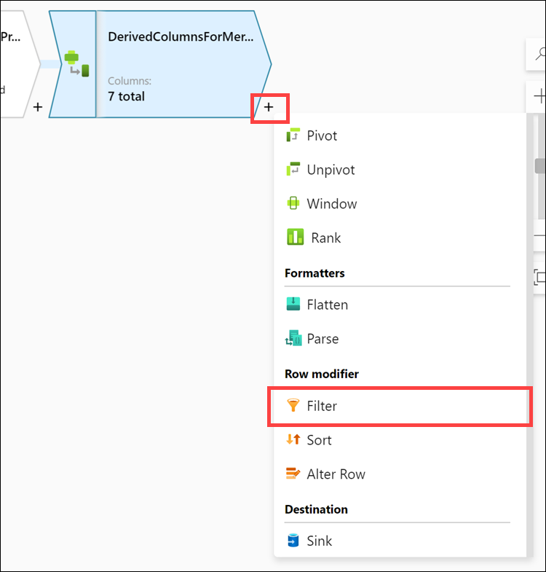
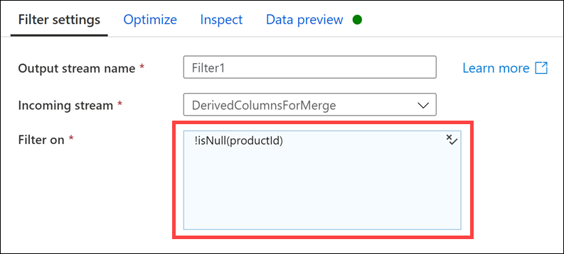
Row modifier transformations
Notes:
Talking points
The row modifiers transformation category include the Filter, Sort and Alter Row transform
Filter
The Filter transforms allows row filtering based upon a condition. The output stream includes all rows that matching the filtering condition. The filter transformation is similar to a WHERE clause in SQL.
Sort
The sort transformation allows you to sort the incoming rows on the current data stream. You can choose individual columns and sort them in ascending or descending order.
Alter Row
Use the Alter Row transformation to set insert, delete, update, and upsert policies on rows. You can add one-to-many conditions as expressions. These conditions should be specified in order of priority, as each row will be marked with the policy corresponding to the first-matching expression. Each of those conditions can result in a row (or rows) being inserted, updated, deleted, or upserted. Alter Row can produce both DDL & DML actions against your database.
Instructor notes and guidance.
The filter transformation will typically make use of expressions to define how the data should be filtered and will be explored in the lab
Recommended reading for this slide
https://docs.microsoft.com/en-us/azure/data-factory/data-flow-filter
https://docs.microsoft.com/en-us/azure/data-factory/data-flow-sort
https://docs.microsoft.com/en-us/azure/data-factory/data-flow-alter-row

Slide 16
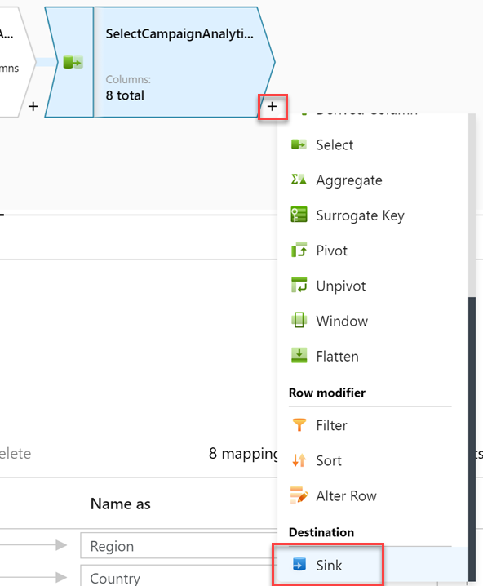
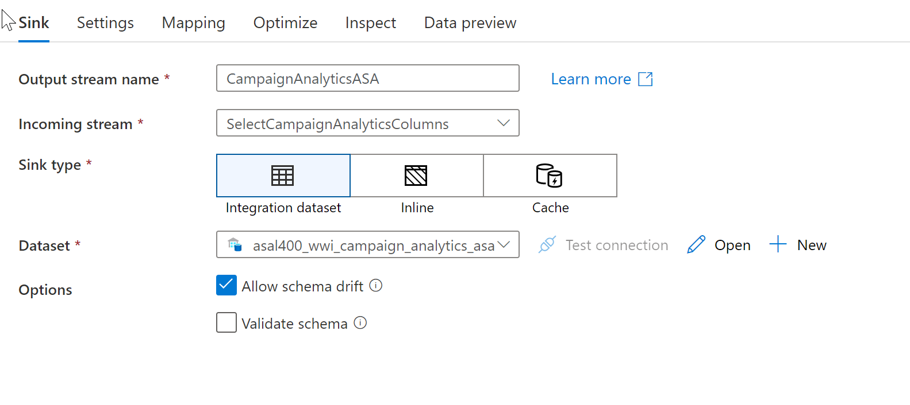
Sink transformation
Notes:
Talking points
After you finish transforming your data, write it into a destination store by using the sink transformation. Every data flow requires at least one sink transformation, but you can write to as many sinks as necessary to complete your transformation flow. To write to additional sinks, create new streams via new branches and conditional splits. Each sink transformation is associated with exactly one Azure Data Factory dataset object or linked service. The sink transformation determines the shape and location of the data you want to write to.
Instructor notes and guidance.
The students will create a data flow that has two sink outputs in the lab
Recommended reading for this slide
https://docs.microsoft.com/en-us/azure/data-factory/data-flow-sink

Slide 17
Review questions
Q01 – You are moving data from an Azure Data Lake Gen2 store to Azure Synapse Analytics. Which Azure integration runtime would be used?
A01 – Azure
Q02 – Which control activity can be used to branch an activity on a condition that evaluates to true or false?
A02 – If Condition activity
Q03 – What feature enables you to interact with the Mapping Data Flow transformations that you create?
A03 – Debug
Notes:
Instructor notes and guidance.
This space has been left deliberately blank

Slide 18
Lab: Transform data with Azure Data Factory or Azure Synapse Pipelines
Notes:
Instructor notes and guidance.
This space has been left deliberately blank

Slide 19
Lab overview
This lab teaches students how to build data integration pipelines to ingest data from multiple data sources, transform data using mapping data flows and notebooks, and perform data movement into one or more data sinks.
Lab objectives
After completing this lab, you will be able to:
Data integration with Azure Data Factory or Azure Synapse Pipelines
Code-free transformation at scale with Azure Data Factory or Azure Synapse Pipelines
Notes:
Instructor notes and guidance.
This lab teaches students how to build data integration pipelines to ingest data from multiple data sources, transform data using mapping data flows and notebooks, and perform data movement into one or more data sinks.
In exercise 1. the students will create the required objects; namely SQL tables, that will be used to store the data that is ingested by the mapping data flow. Then they will define the required linked services to connect to the data sources to consume the data, followed by pointing to the datasets within the linked services. Note that the students will be dealing with a poorly formatted data while creating these datasets, and how to handle it in a linked service.
In exercise 2, and exercise 3, the students will use a Mapping Data Flow to create a campaign analytics data pipeline, and the top product purchases respectively. This gives the students a couple of examples of how the Mapping data flow can be used to transform data using Azure Data Factory/Azure Synapse pipelines.
In exercise 4, the students will trigger the execution of their work, and learn how they can monitor the execution of the pipelines that they have created.

Slide 20











Lab 08 Overview
asacosmosdb<unique_suffix>
CosmosDB
Campaign Info
Azure Databricks
asagadatalake<unique_suffix>
Cluster
Azure Data Lake
wwi-02
Profiles (json)
dp203sql<unique_suffix>
SourceDB
Synapse Analytics
Dedicated SQL Pool (SQLPool1)
Built-In Serverless SQL Pool
Apache Spark pool
Pipelines and Dataflows
Power BI
asagaworkspace<unique_suffix>
Notes:
This slide is an optional slide that you can use to show a high-level overview of the technologies used in the lab.
This lab teaches students how to build data integration pipelines to ingest from multiple data sources, transform data using mapping data flows and notebooks, and perform data movement into one or more data sinks.

Slide 21
Lab review
Question 1 – What are the first two components do you create in Azure Data Factory/Azure Synapse Pipelines to connect to data in a data source?
Question 2 – Which mapping data flow transformation enables you to remove records during the execution of a data flow?
Question 3 – How can you save and persist the work that you create in Azure Data Factory/Azure Synapse Pipelines?
Question 4 – How can you view detailed information about a data flow?
Notes:
Answers
Question 1 –You first create a linked service, followed by an integration dataset to connect to data in a data source
Question 2 – The filter transformation enables you to remove records during the execution of a data flow.
Question 3 – It is very important to click on Publish/Publish All. Otherwise you will loose any work that you have created
Question 4 – In the monitor section, click on Pipeline runs, click on the data flow of interest, and then click on the Data flow details icon (represented by a glasses icon) to view the detailed information

Slide 22
Module summary
In this module, you have learned about:
Data integration with Azure Data Factory or Azure Synapse Pipelines
Code-free transformation at scale with Azure Data Factory or Azure Synapse Pipelines
Next steps
After the course, consider visiting [the Microsoft Customer Case Study site]. Use the search bar to search by an industry such as healthcare or retail, or by a technology such as Azure Synapse Analytics or Azure Data Factory. Read through some of the customers stories
Notes:
Instructor notes and guidance.
The next steps is suggested post course learning materials to reinforce what they have learned in the module.

Slide 23
Closing slide
Notes:
Instructor notes and guidance.
This space has been left deliberately blank

